Slide 1
Lariat analysis
Capstone 1

Slide 2
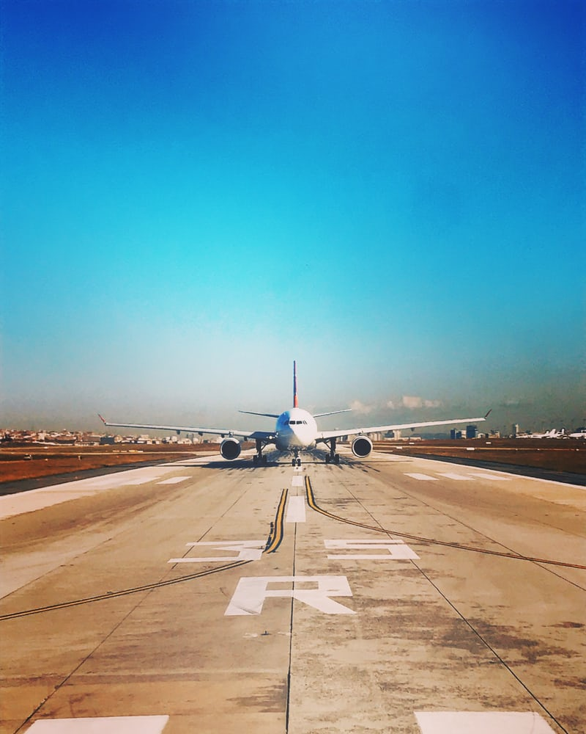
The goal
Minimizing cost
Focus on the car costs
The profitable cars VS The least profitable cars
Maximizing revenue
Focus on the branches
At the airport VS Not at the airport

Slide 3
Average comparison of cars
Notes:
Base data is 11 months. To know Monthly revenue, yearly revenue divided by 11 months. Focus on bottom 3 cars. Not bringing enough money to cover monthly cost.

Slide 4
Minimizing cost (The profitable cars VS The least profitable cars)
Notes:
There are some cars which are not making money. Focus on bottom 3 cars

Slide 5
Maximizing revenue (At the airport VS Not at the airport)
At the airport
22 branches
Not at the airport
28 branches
Total revenue
$29,584,268
Total revenue
$23,245,939
Average revenue
$1,056,633
Average revenue
$1,056,581
The difference of average revenue
$52
Notes:
Difference $52.59 (branch at the airport’s average revenue is more)

Slide 6
Revenue comparison of branches
Scale starts at $920,00 to show difference.
Notes:
Las Vegas branch is the lowest revenue and the only one branch which is not reaching 1 million revenue.

Slide 7
Strategy 1 Get rid of 3 least profitable cars to minimize the cost. (Car model: Colt, Town car, Navigator)
Monthly total cost
$2,751,139
Revenue for 11 months
$52,813,808
Cost decrease relative to base
$5,251
Revenue increase relative to base
-$16,399
Notes:
Car model: Colt, Town car, Navigator

Slide 8
Strategy 2 Close the lowest branch and add 1 airport branch. (Close Las Vegas branch and add a branch at McCarran airport)
Monthly total cost
$2,756,390
Revenue for 11 months
$52,891,326
Cost decrease relative to base
$0
Revenue increase relative to base $61,119
Notes:
Adding ave of revenue $1,056,633.59

Slide 9
Strategy 3 Close any branches not at the airport and add branches at the airport. (same number of branches, in this case 3 branches)
Monthly total cost
$2,756,390
Revenue for 11 months
$52,830,364
Cost decrease relative to base
$0
Revenue increase relative to base $157
Notes:
Add and minus ave of revenue (add $1,056,633.59 minus $1,056,581.00) , this case 3 branches

Slide 10
Conclusion (combine strategies 1 and 2) Close the lowest revenue branch, add 1 airport branch and get rid of 3 least profitable cars.
Monthly total cost $2,751,139
Revenue for 11 months
$52,874,927
Cost decrease relative to base
$5,251
Revenue increase relative to base $44,720
Notes:
Compare to 2018, profit increase $102,487.53

Slide 11

Any questions?

Slide 12
Thank you so much for your kind attention.

